Slide 1


Slide 2







Slide 4








Slide 7



Slide 8
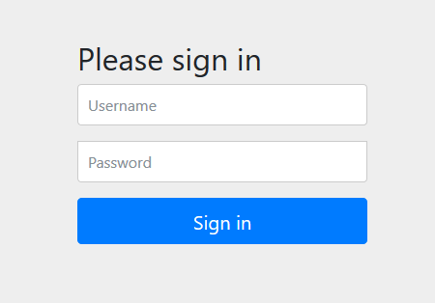

Slide 11




Slide 12



Slide 13


Slide 15










Slide 17


Slide 18









Slide 19


Slide 20








Slide 21




Slide 22


Slide 23



Slide 24




Slide 25


Slide 27




Notices changes in your configuration, code and
classpath.
Makes assumptions on what you want to
achieve.

Slide 29





Slide 30


Slide 31



Slide 32


Slide 33


Slide 36







Slide 39



Slide 41


Slide 42




Slide 43


Slide 44






